Slide 1
Investigation of the Long-Coexisting, Ecologically Distinct Lineages within Species
Jocelyn

Slide 2
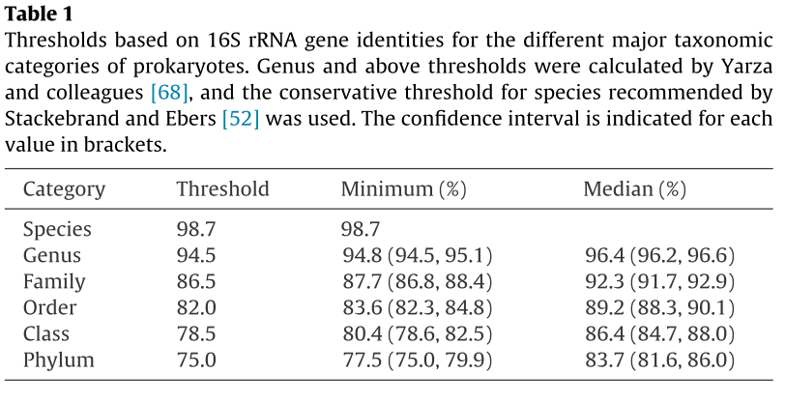
Molecular approaches toward demarcating bacterial diversity….
How you know you have a novel genus, phylum, and so on….
No threshold agreed upon below the species level
So, if your novel organism has a 16S rRNA gene that is <75% identical to any known phylum, you’ve discovered a new phylum!

Slide 3
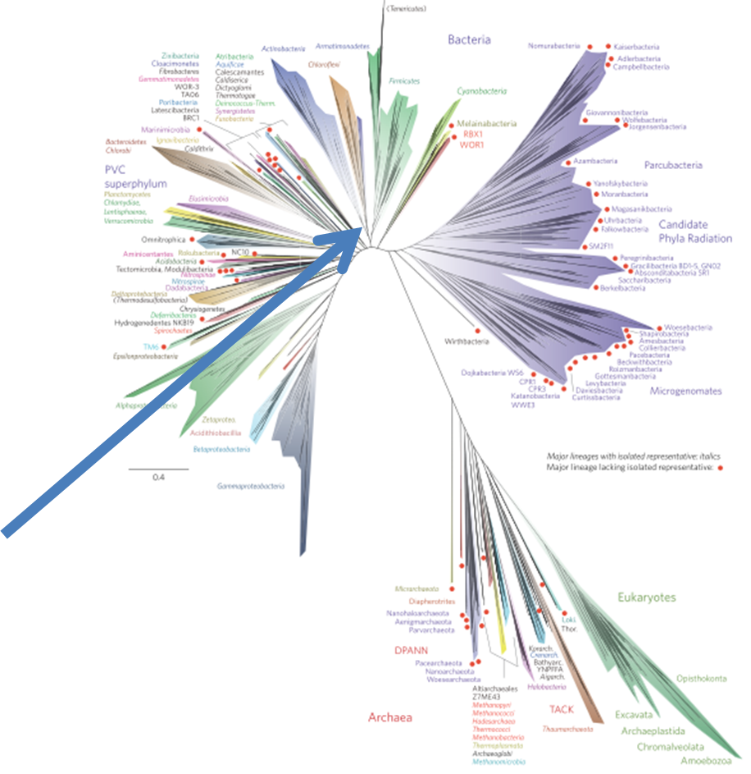
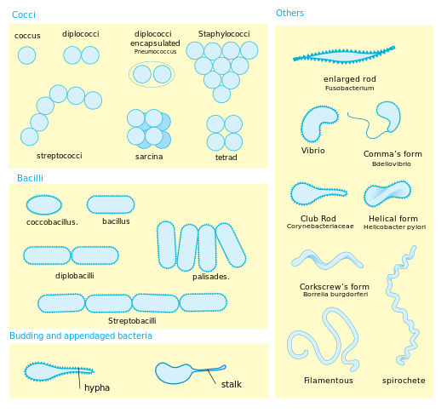
Beyond clustering at some level, are there dynamic properties of species?
A dynamic property of species—one lineage splits into two that can coexist and diverge indefinitely
Phyla utterly different in:
Cell architecture
Genome content
Biochemistry
Physiology
How they make a living
~30 cultivated phyla
~100 phyla by 16S
Estimated ~1300 phyla!
Each pair of phyla originated as a splitting of one species into two.
Hug et al. 2016.

Slide 4
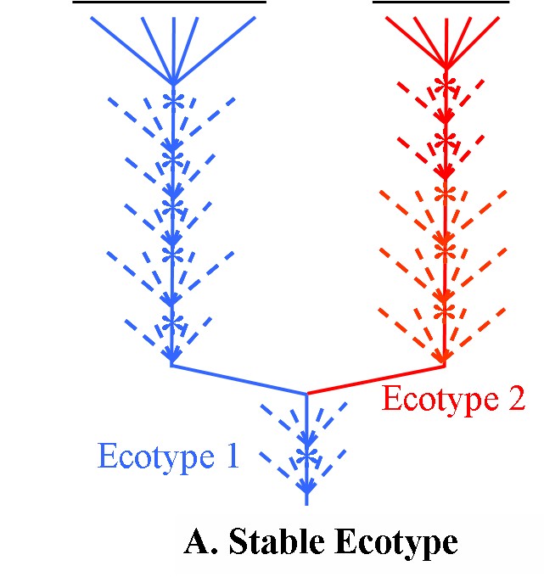
A dynamic property: Cohesion
In animals and plants, recombination between populations.
In rarely sexual organisms—periodic selection….
Species 2
Species 1
The Origin of Bacterial Species

Slide 5
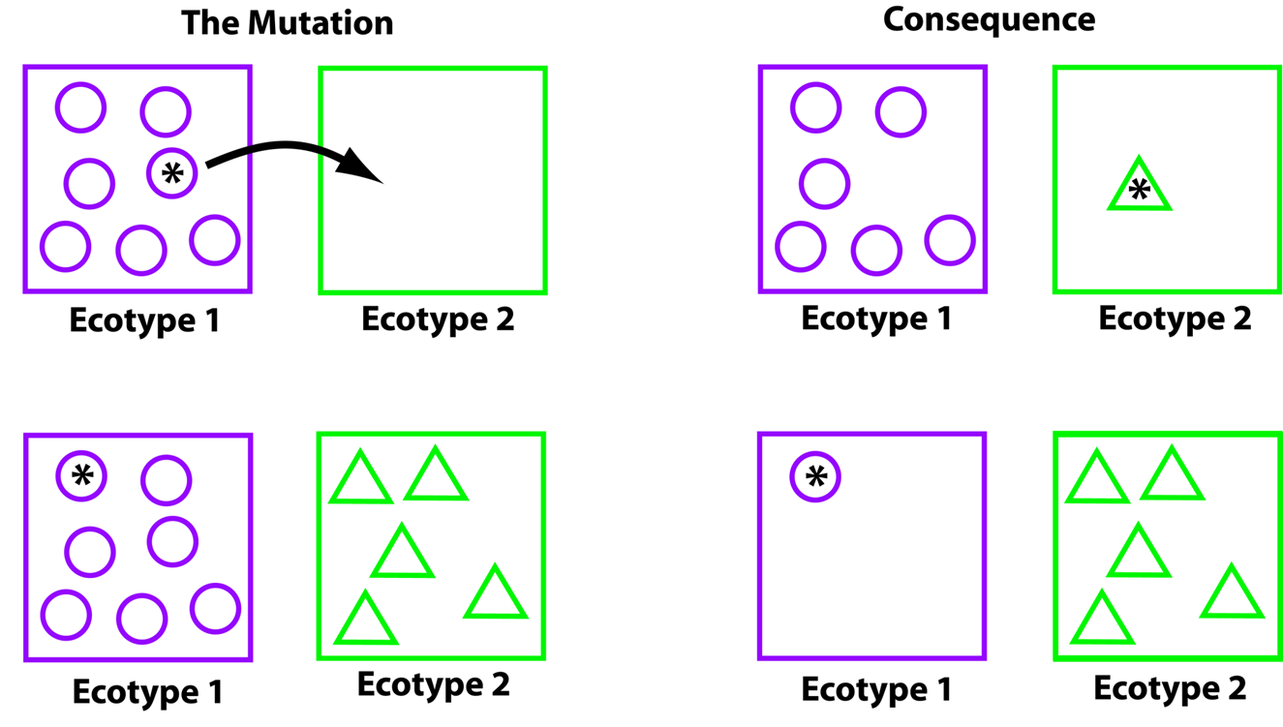
A dynamic property: species are ecologically distinct.
Stable Ecotype model: ecotypes as ecologically distinct, genetically cohesive, and irreversibly separate.
+
+
Long-term coexistence of ecotypes

Slide 6
Our algorithm, Ecotype Simulation, for demarcating the sequence clusters that are the domains of extinction of periodic selection events.
Ecotype simulation—a maximum likelihood model to determine the rates of evolutionary processes, including ecotype formation (EF), periodic selection (PS), and drift (D), as well as the number of ecotypes in a sample of organisms.
Ecotype 1
Ecotype 2
Ecotype 3
t₁
t₂
E₁
E₂
E₃
D
D₁
t₃
PS
D₂
t₄
PS
t₅
EF
Danny Krizanc
t₆
EF
Cohan and Perry. 2007. Current Biology 17:R373-R386.
Koeppel et al. 2008. PNAS 105:2504.
Francisco et al. 2014. Accuracy and efficiency of algorithms….
Wood et al. 2023. Ecotype Simulation 2….
PS
Most recent common ancestor of all sampled organisms
PS
Jason Wood

Slide 7
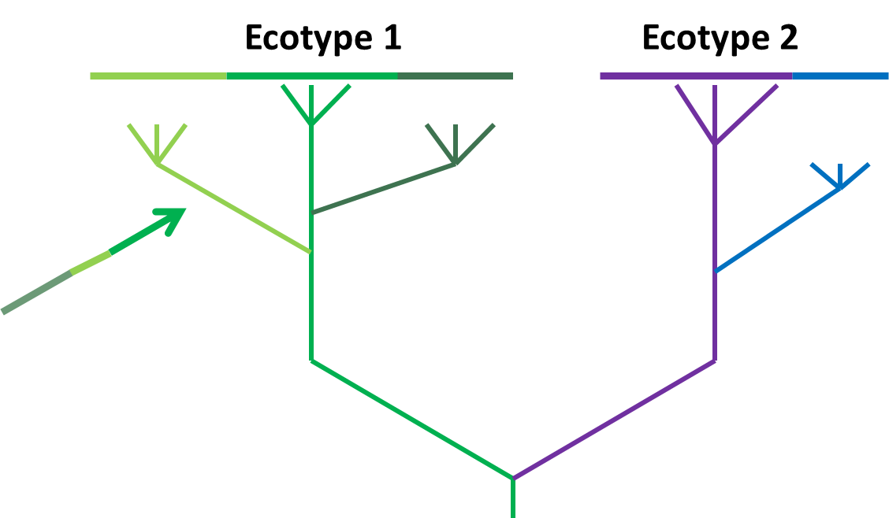
The newest species—Ecotypes
1. Ecological distinctness among ecotypes.
2. Ecological homogeneity within an ecotype.
Ecologically distinct lineages within an ecotype are too similar to persist indefinitely.
How many ecotypes (as the domain of extinction of periodic selection events) exist within a species?

Slide 8
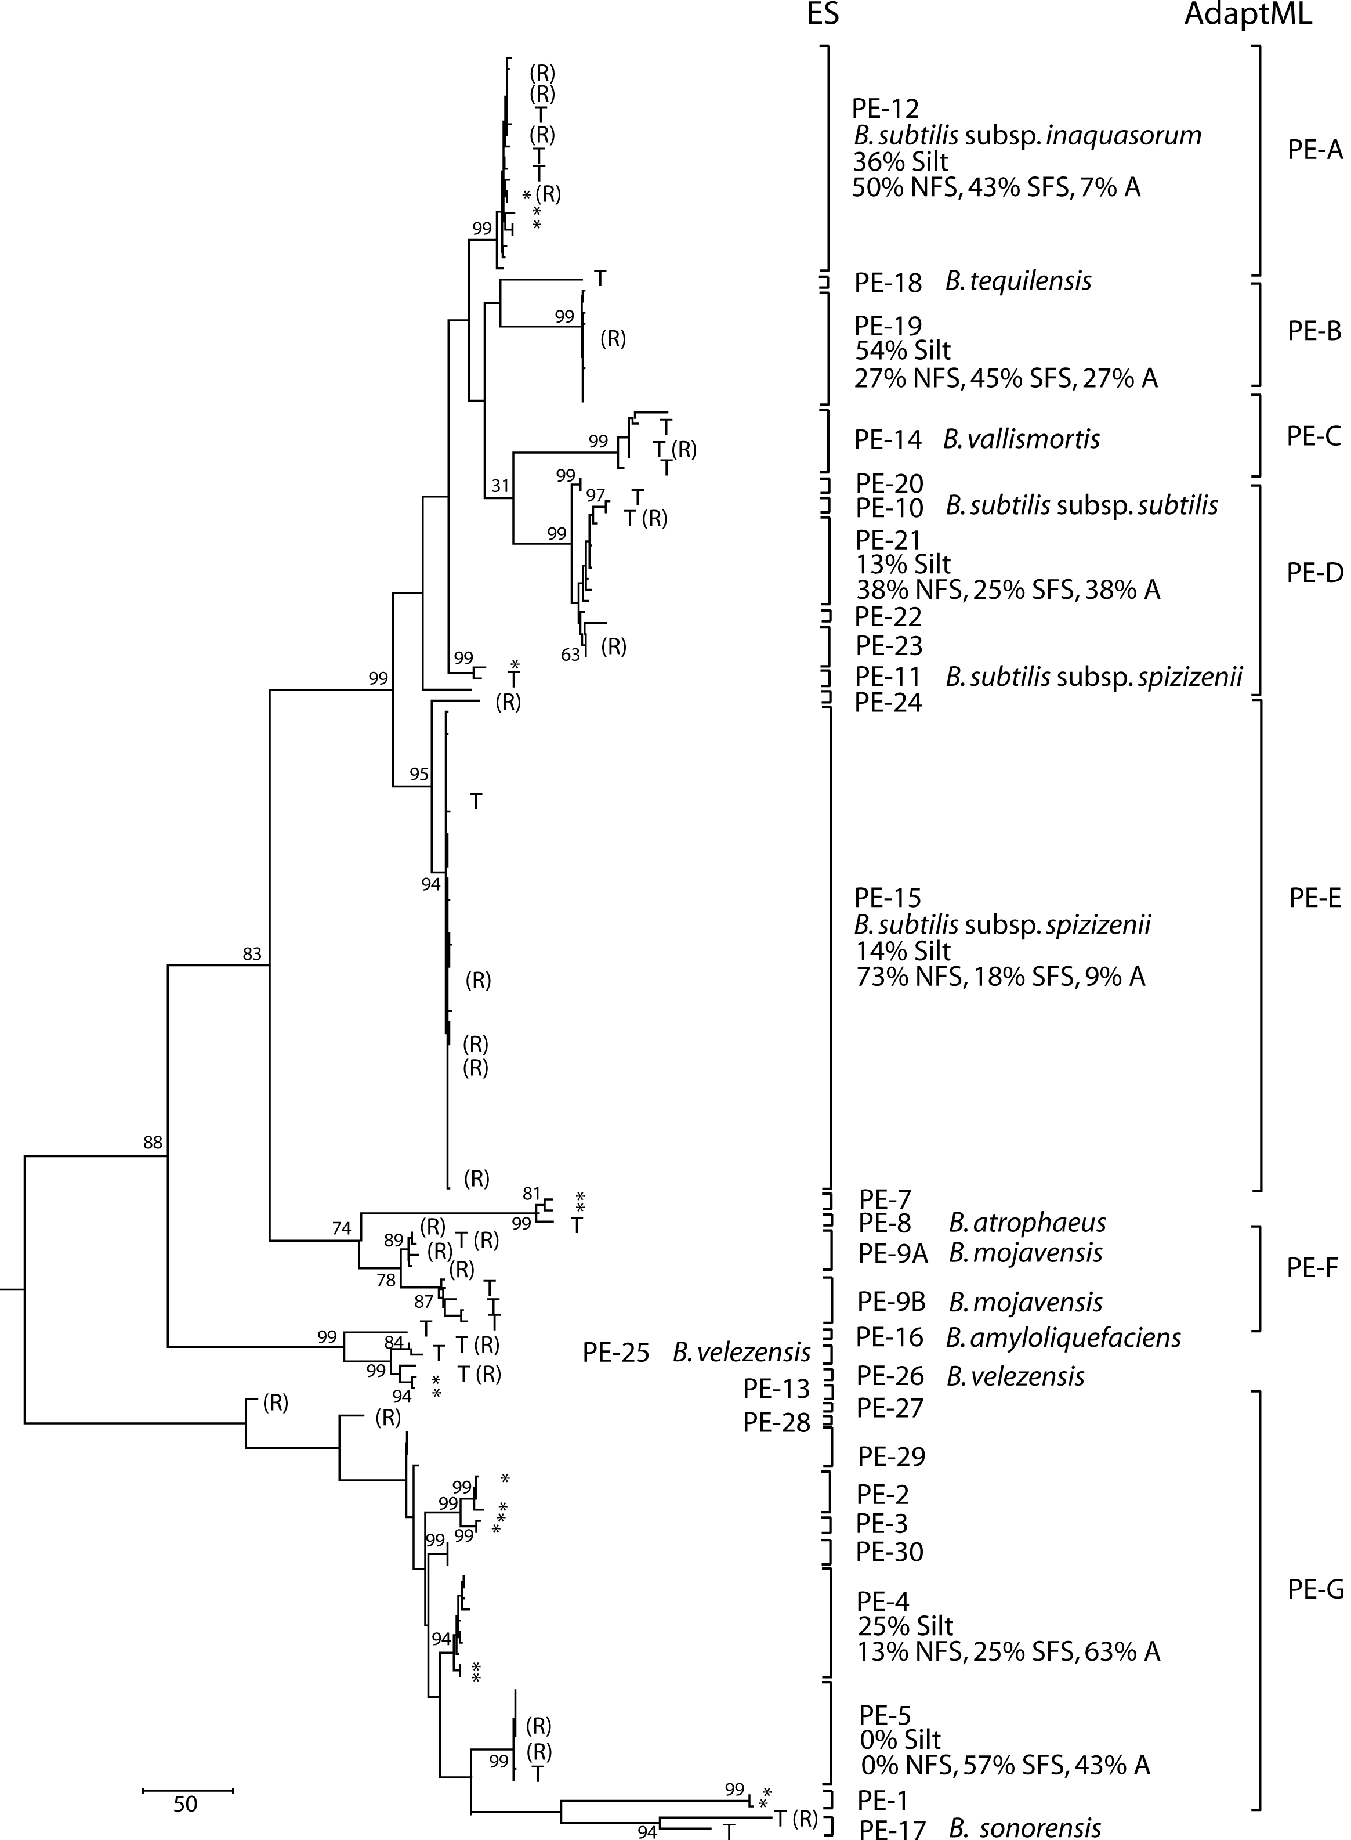
Applying Ecotype Simulation on 3 genes yields few ecotypes per species taxon
Our outgroup, strain 168 of PE10, within B. subtilis
Our focus clade.
Are the members of this putative ecotype (PE15, within B. spizizenii) homogeneous in their ecological adaptations?

Slide 9
Why does low-resolution (3 genes) analysis yield few ecotypes?
There really are very few ecotypes that have a history of selective sweeps through periodic selection
There are many ecotypes with a history of selective sweeps, but we require more resolution (e.g., a whole genome) to detect them.
And so, we provide a core-genome-based Ecotype Simulation!
Ecotypes are the most newly divergent, ecologically distinct lineages with species properties.
Each recognized species taxon has multiple ecotypes!
Our goal—to produce an ecotype-level systematics of Bacillus species

Slide 10
Outline
run TYGS to identify species
run through Prokka to generate genome annotation of each strain
run Roary to get a core genome alignment (99%)
dereplicate clones using complete linkage clustering algorithm
generate bootstrapped phylogenetic trees using IQTree
rarefaction
habitat association and walking up tree approach

Slide 11
Rarefaction Approach
to test whether there might really be an infinite number of ecotypes that we could detect if we had greater molecular resolution
How?
Rarefaction using real genes
Identify all the genes in core genome alignment (using ffn files from Prokka and blastn)
Generate random genome samples (500 samples for each gene number) by concatenating certain number of real genes (gene length >= 500)
Sample with replacement to ensure every sample is different
Rarefaction using “fake” genes
Randomly take disjoint segments (1000 bps each) from core genome alignment
Generate random genome samples (500 samples for each gene number) by concatenating those segments
For one species, we run Ecosim 6000 times using both real and “fake” gene samples

Slide 12
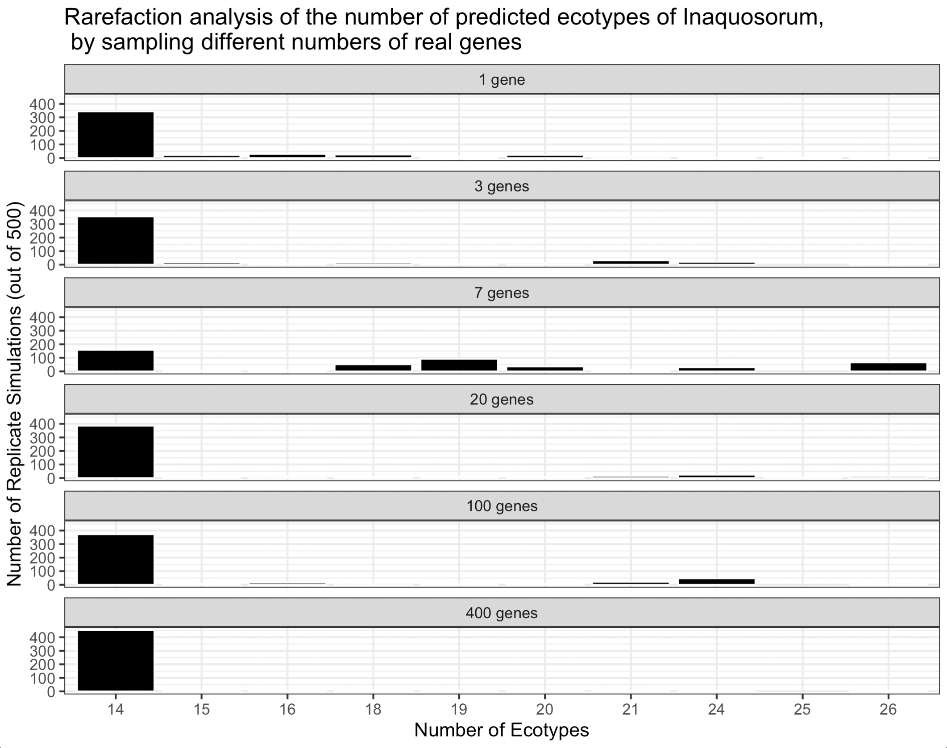

Slide 13
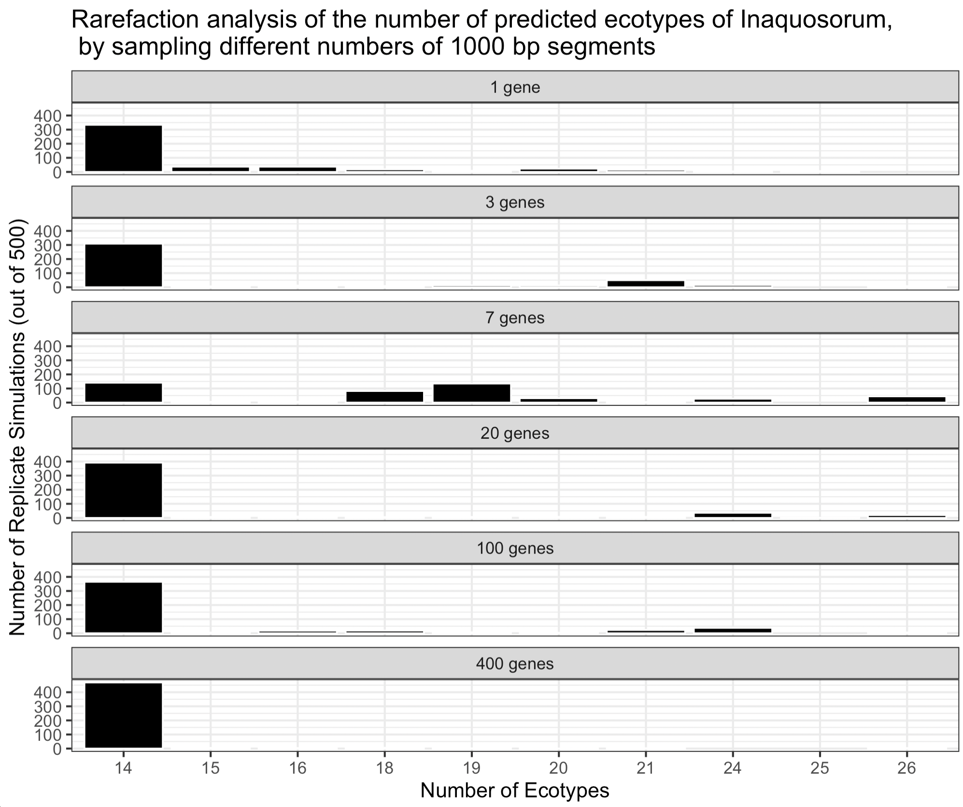

Slide 14
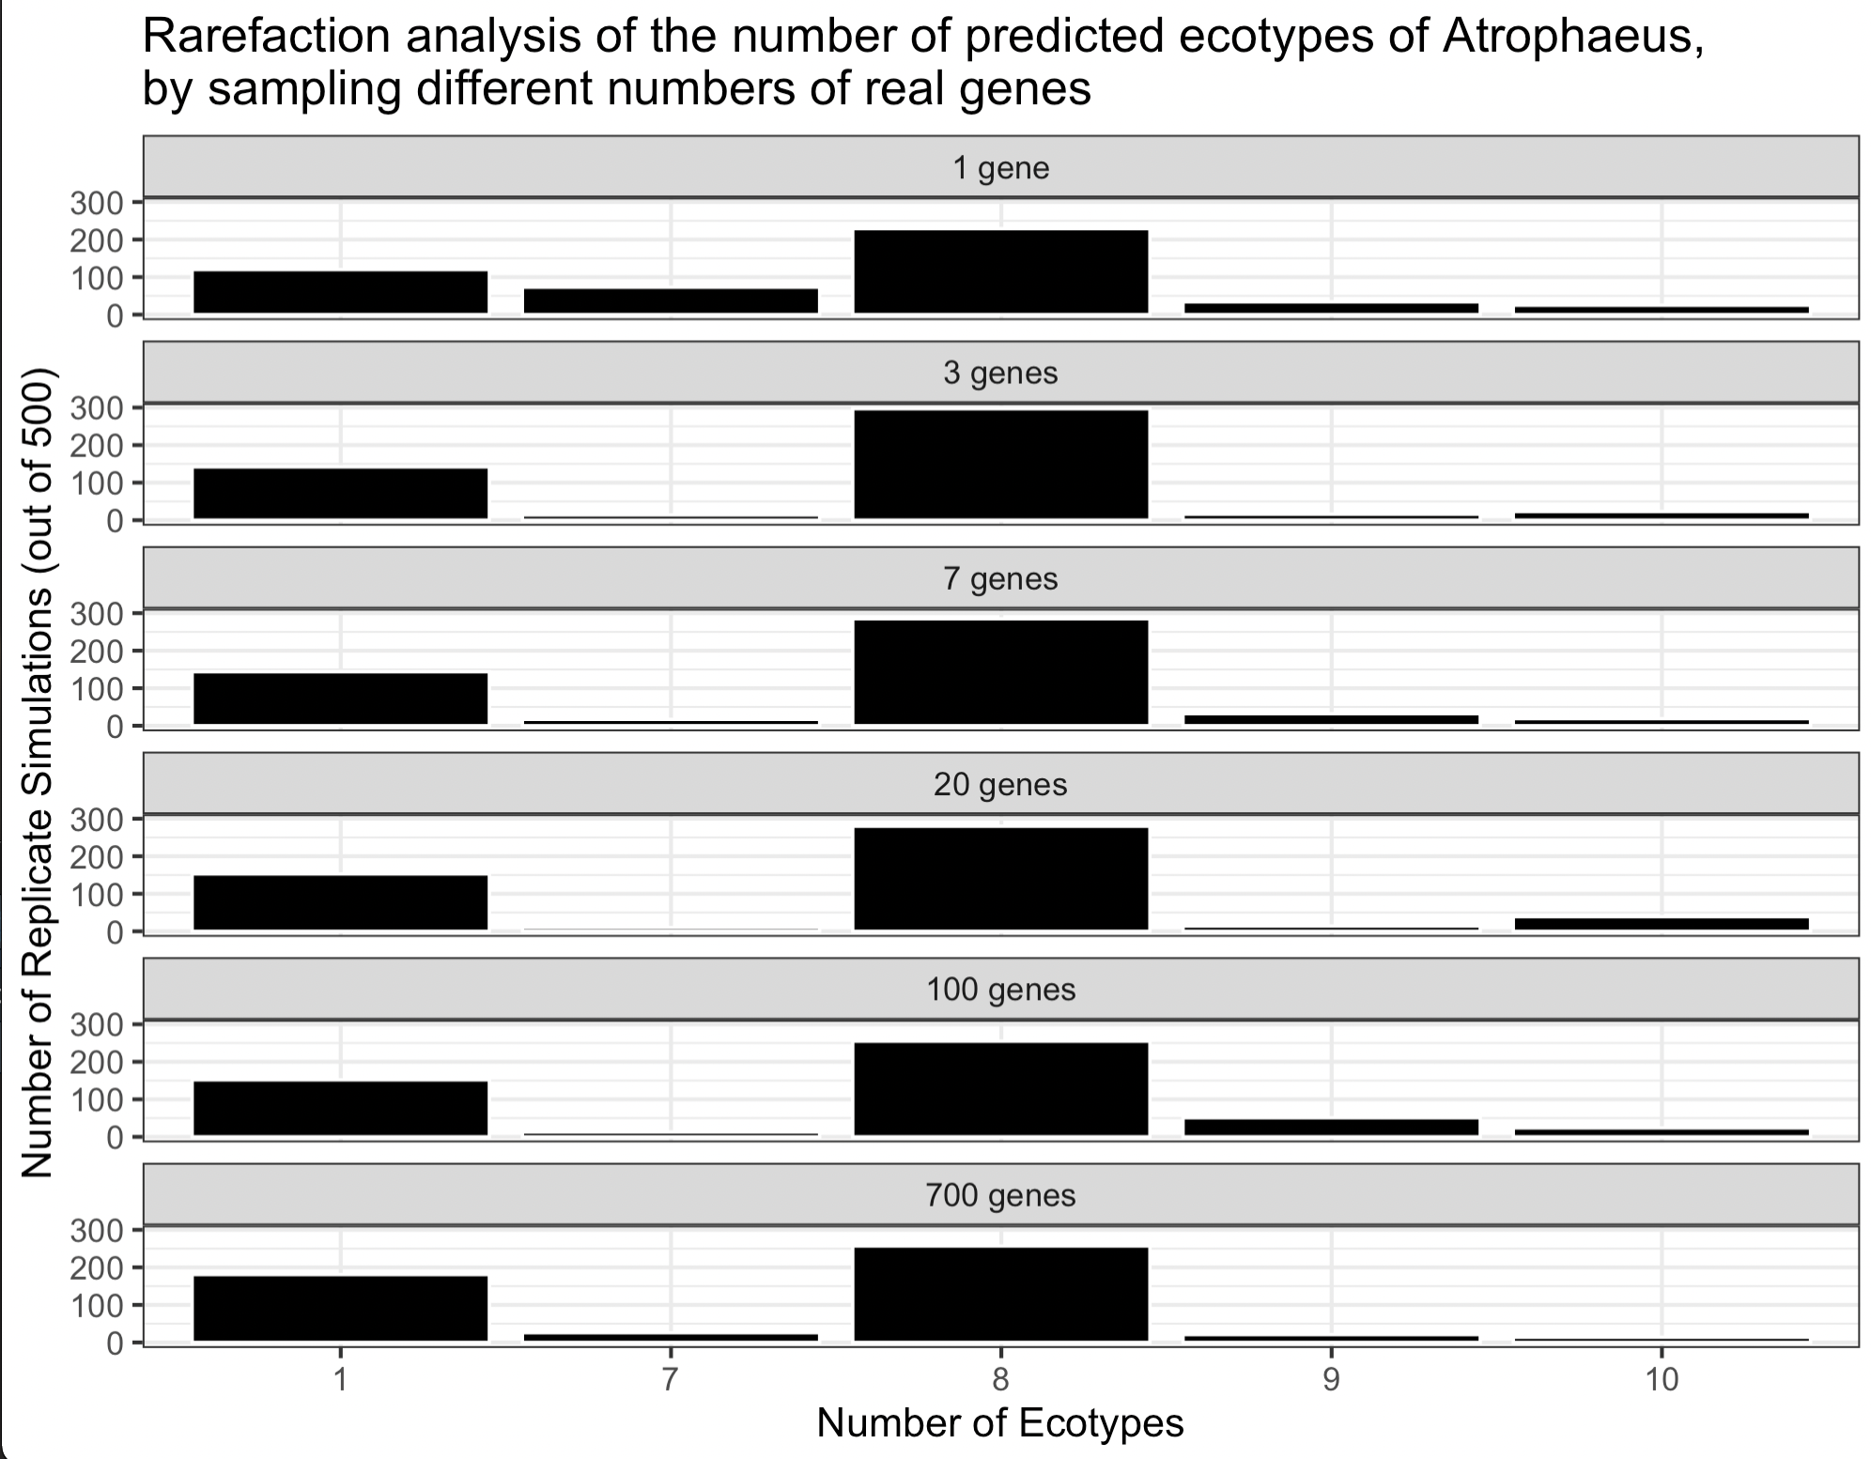

Slide 15
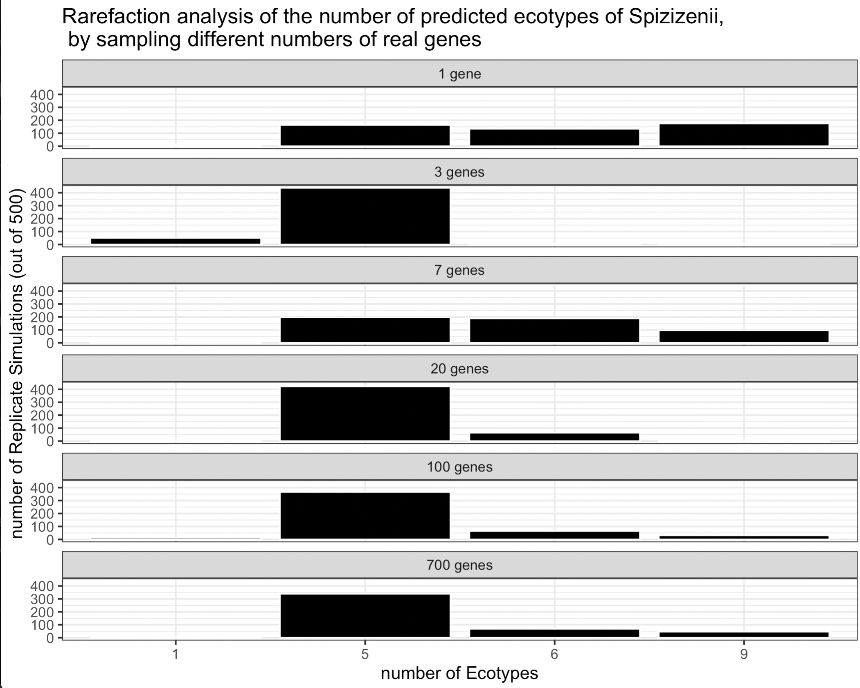

Slide 16
Summary
we are getting almost the same number of ecotypes predicted regardless of gene number!
Consistent with the hypothesis that there really are only a small number of stably coexisting ecotypes within each species

Slide 17
Future work
What are the genes?
A program that keep track of gene names during rarefaction
A high-throughput survey of these genes (PCR then sequencing)

